Slide 1
Machine Learning Advanced “LetterRecognition” Dataset
Lets ANALYSE and Create the MODEl to predict ALPHABETS on the basis of large number of black-and-white rectangular pixel BOX Features.

Slide 2
What we are analyzing and achieving
We are analyzing the data within the LetterRecognition dataset with different preprocessing technique like: shape, info, description etc.
We see data through different graphs like: barplot.
We will see how explanatory variables are explaining the target variable.
We will try to make the data ready to be used as train and test set by separating target and feature variables.
We will try to create and compare models to better predict the target variable( which are alphabets).

Slide 3

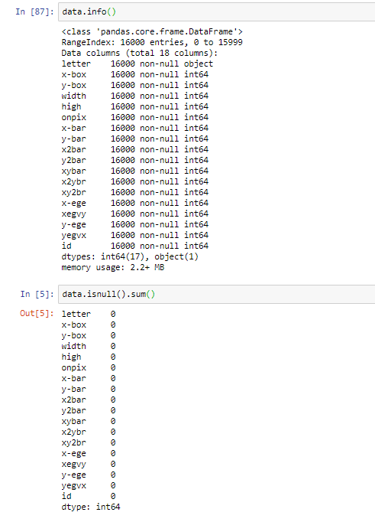
Data Analysis
There are total 18 columns and having 16000 rows.
We see that there is no missing/null values and so we don’t need to fill any values.
We have all continuous columns except “letter”which is target variable and string in type.

Slide 4
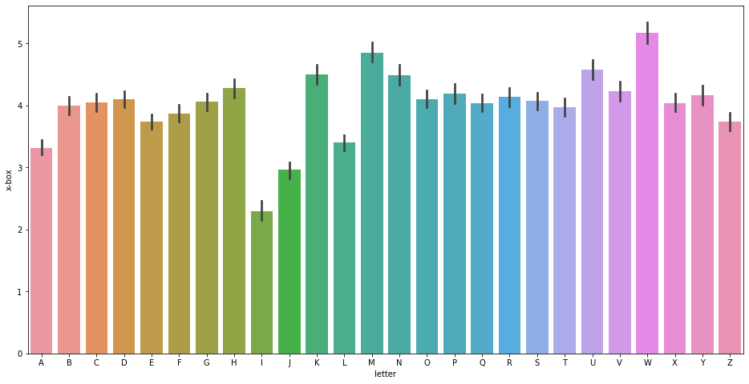
Data Analysis
We have created barplot with columns x-box and letter.
We see I has minimum value and W has maximum as you can see the bars.
The above statement signifies the most simplistic ( A ) and most wide/complex( W ) design of alphabets.
M has second largest value as it has similar design as W but less wide and different orientation.

Slide 5
Modelling and Prediction
We have applied 4 classification algo so as to compare which one is best.
Accuracy:
Random Forest Classifier : 96.125%
KNN : 94.59%
XGBoost : 83.69%
Support Vector Classifier : 97.28%
We clearly see that RFC and SVM wins here as per accuracy score and we will apply our LetterRecognition Test Dataset with these two algorithms.

Slide 6
Analysis and Observation
We have applied four classification approaches: Random Forest Classifier, KNN, XGBoost and Support Vector Classifier
After evaluation through accuracy score, we observed that Random Forest Classifier and Support Vector Classifier better predict the alphabets which is target variable here.
We have applied test dataset on both algo. and saved the prediction in separate csv which shows same prediction on test dataset.

